Slide 1

Credit card lead prediction
Sit Dolor Amet

Slide 2
Problem statement
Classification problem
Target feature : Is_Lead
Features : Gender,Age, Region_Code, Occupation, Channel_Code, Vintage, Credit_Product, Avg_Account_Balance, Is_Active.
Objective: Identify the customers who will show higher intent towards recommended credit card.

Slide 3
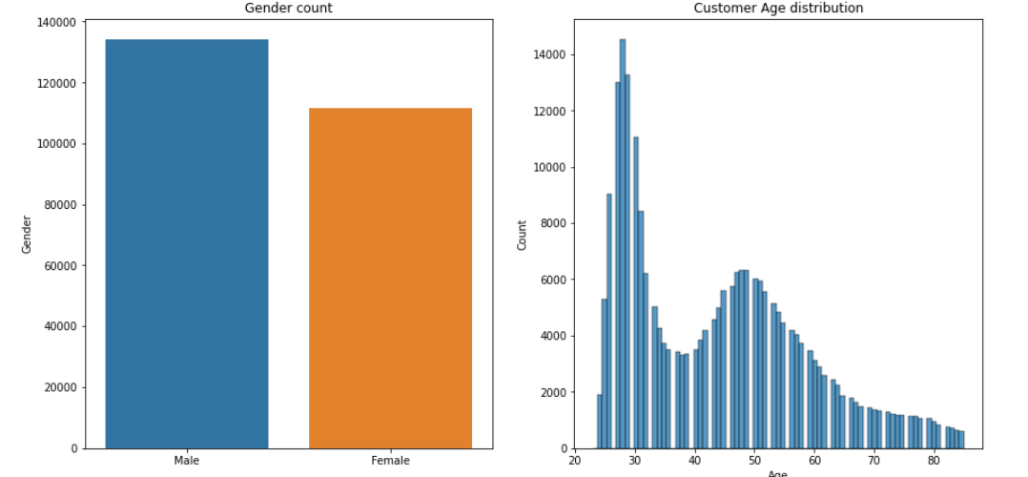
Exploratory data analysis
Male customers are higher than female customers as shown in the chart
Most of the customers of the bank are in the age group of 20-30 & 45-55 years

Slide 4
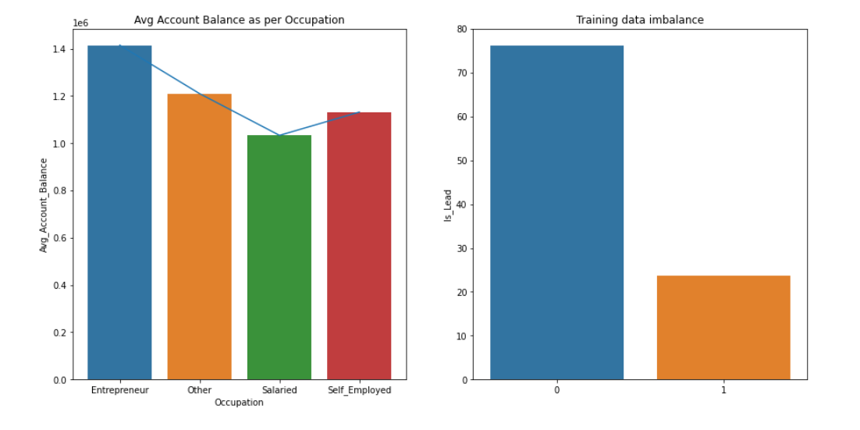
Exploratory data analysis
Average balance of customers whose occupation is Entrepreneur are highest among other occupation customers
The train data has imbalance since the customers who opted is very less compared to the customers who didn’t opt.

Slide 5
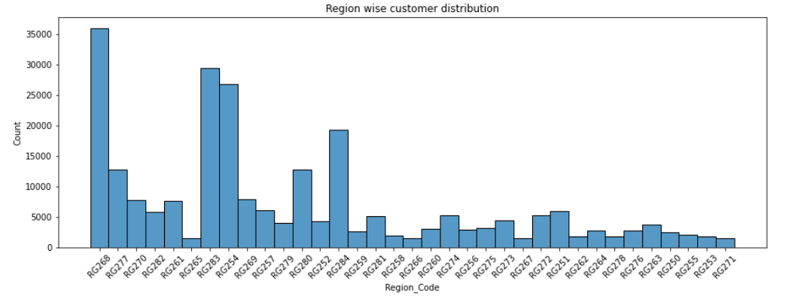
Exploratory data analysis
We can observe most of the customers are from region RG268 & RG261 has least number of customers

Slide 6
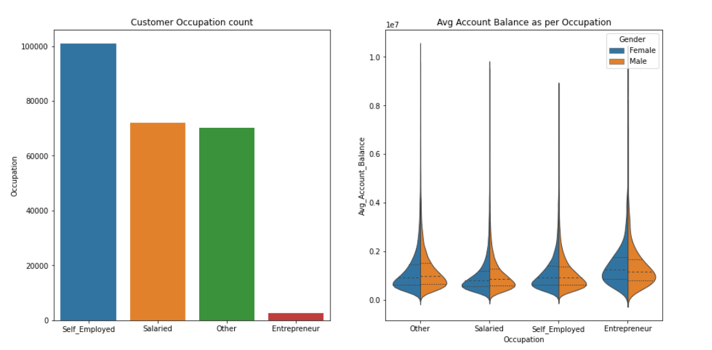
Exploratory data analysis
We can observe from the chart that most of the customers of the bank are self employed whereas Entrepreneurs are the very less in number.
We can see almost same average annual balance distribution between male and female customers

Slide 7
Data preprocessing
Checked for null values in train dataset.
Assumed ‘No’ value for credit_product where there was NAN.
Deleted duplicate values.
Target encoded Region code and Vintage features
Feature engineered
Age_bins(divided age in to 4 bins [0-25],(25-50],(50-75],(75-100])
Vintage_years (Added a feature by dividing vintage months with 12 months)
Divided categorical columns and numerical values
Dummyfied the categorical columns
Split the train data in 70:30 %

Slide 8
Model Building
Tried with ML models such as
Naïve Bayes classifier
Decision Tree
RandomForest
SVM
ANN
AutoML

Slide 9
Model building
Random forest performed better than other models
Fine tuned the models with the hyperparameters
GridsearchCV was used to find the best parameters for Random forest and Decision Tree

